Slide 1






Lecture 18:
Storage & Advanced Functions
Course - Web Development - II
-By
Instructor Name
‹#›
welcome@krmangalam.edu.in
Sohna Road,Gurugram,Haryana 122103

Slide 2

| Table of Contents
Local Storage
Session Storage
Cookies Storage
Generators & currying
References
The End
‹#›

Slide 3
|
Local Storage
Local Storage is a browser storage mechanism that allows us to store data in the form of key–value pairs.
The data stored in Local Storage does not expire and remains available even after the browser is closed or the system is restarted.
Key Characteristics
Data is stored per domain
Data is stored as strings
Maximum size is around 5–10 MB
Data remains until manually removed
‹#›

Slide 4
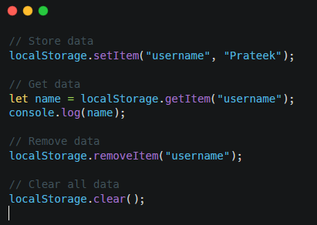
|
Local Storage
Common Use Cases
Saving user preferences (theme, language)
Storing tokens (not recommended for sensitive data)
Remembering login state (basic apps)
Important Note
Local Storage is not secure.
It should never be used to store passwords or sensitive information.
‹#›

Slide 5
|
Session Storage
Session Storage is similar to Local Storage, but the data is stored only for one browser session.
Once the browser tab or window is closed, the data is automatically deleted.
Key Characteristics
Data exists only while the tab is open
Data is not shared across tabs
Stored as key–value pairs
Size limit similar to Local Storage
‹#›

Slide 6
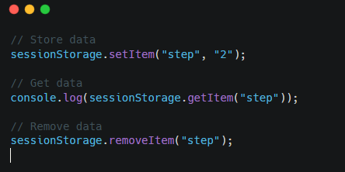
|
Session Storage
Common Use Cases
Temporary form data
Multi-step forms
One-time session data
‹#›

Slide 7
|
Cookies Storage
Cookies are small pieces of data stored in the browser and sent to the server with every HTTP request.
They are mainly used for authentication, tracking, and session management.
Key Characteristics
Stored as key–value pairs
Automatically sent to server
Can have an expiry date
Size limit is around 4 KB
More secure than local storage (when using flags)
‹#›

Slide 8
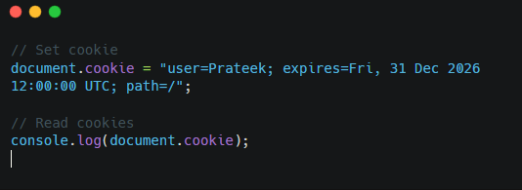
|
Cookies Storage
Cookie Security Flags
HttpOnly → not accessible via JavaScript
Secure → sent only over HTTPS
SameSite → prevents CSRF attacks
‹#›

Slide 9
|
Cookies Storage
Feature | Cookies | Local Storage | Session Storage
Sent to server | Yes | No | No
Size | ~4 KB | ~5–10 MB | ~5 MB
Expiry | Yes | No | Tab-based
Security | High (with flags) | Low | Low
‹#›

Slide 10
|
Generators
A Generator is a special type of function that can pause its execution and later resume from the same point.
Generators are created using function* and use the yield keyword.
Why Generators are Used
To control execution flow
To generate values one by one
To save memory
To handle large data streams
‹#›

Slide 11
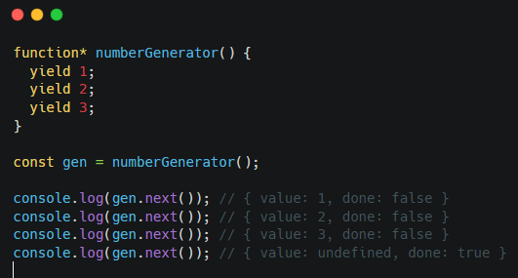
|
Generators
Key Points
yield pauses the function
next() resumes execution
Generators return an iterator
‹#›

Slide 12
|
Currying
Currying is a functional programming technique where a function with multiple arguments is transformed into a sequence of functions that take one argument at a time.
Why Currying is Used
Improves code readability
Helps in function reuse
Used heavily in functional programming
‹#›

Slide 13
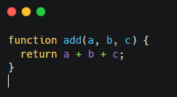
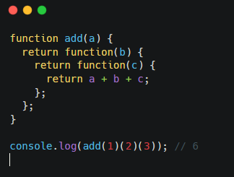
|
Currying
Example (Normal Function)
Curried Version
‹#›

Slide 14
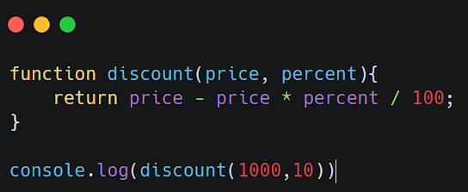
|
Currying
Real-World Use Case :
Suppose there is a discount system.
Normal function
‹#›

Slide 15
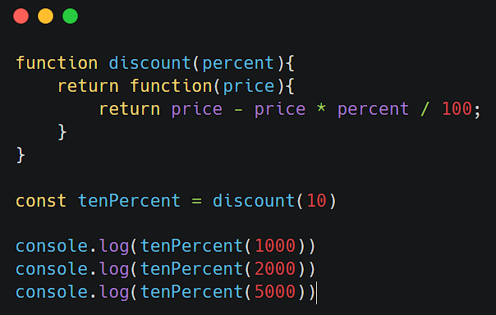
|
Currying
Real-World Use Case :
Suppose there is a discount system.
Curried Version
‹#›

Slide 16

| Check Your Understanding
Question : Which storage stores data permanently in browser
Options : A. Session Storage
B. Cookies
C. Local Storage
D. Cache
Answer : C. Local Storage
Explanation:
Local Storage stores data permanently until it is manually removed.
‹#›

Slide 17
| Check Your Understanding
Question : Which storage is automatically sent to the server with every HTTP request?
Options : A. Local Storage
B. Session Storage
C. IndexedDB
D. Cookies
Answer : D. Cookies
Explanation:
Cookies are attached to every HTTP request and sent to the server.
‹#›

Slide 18
| Check Your Understanding
Question : What is the main purpose of Generators in JavaScript?
Options : A. To execute code faster
B. To pause and resume function execution
C. To store data in memory
D. To handle HTTP requests
Answer : B. To pause and resume function execution
Explanation:
Generators use yield to pause execution and next() to resume it.
‹#›

Slide 19
| References
MDN Web Docs : Comprehensive and official documentation for JS. 🔗https://developer.mozilla.org/en-US/docs/Web/JavaScript
W3Schools – JS Tutorial : Beginner-friendly JS tutorials with examples and interactive editors. 🔗 https://www.w3schools.com/js/
JavaScript.info - A comprehensive tutorial-style website that covers core JavaScript concepts in depth.
🔗https://javascript.info/
‹#›

Slide 20

Thanks
For
Watching
Course - Web Development - II
‹#›
welcome@krmangalam.edu.in
Sohna Road,Gurugram,Haryana 122103

